Slide 1


FEBRUARY 2026
PULSE PLAYBOOK
SUNGLASS HUT
SUMMER 2026 PROPOSAL

Slide 2

Pulse Playbook
for Sunglass Hut
Your strategy starts here.
The Pulse Playbook is the only system that unifies creative, audience, and media — now directly connected to the proposal.
It decodes your creative, benchmarks it against the market, and pinpoints the audiences and placements that fit your brand’s DNA driven by creative signals, not assumptions.
Built on proven holiday campaign learnings and optimized for summer behavior — travel, festivals, outdoor culture, and the moments that define the season.

Slide 3
PurePlay x Sunglass Hut
Overview
PurePlay helps Sunglass Hut unify creative, audience, and media strategy to drive smarter reach, stronger resonance, and measurable growth. With the PurePlay Pulse Platform, we uncover where Sunglass Hut connects most — reaching audiences actively seeking their next pair of shades for summer. By refining audience strategy and media mix around Sunglass Hut's style-driven creative strengths, PurePlay drives stronger brand affinity and measurable growth in store visits and sales.
Campaign Details
Launch Date | Summer 2026 (14 Weeks)
Screens | CTV, OLV
KPIs | CPV
Sports Cap | < 35% of total delivery
Freq Cap | 8-10 per users per month
Brand Safety | IAS 93% / 75% view / <2% IVT
Audiences
Primary:
A 25-54, HHI $50K+
Secondary/Test:
Adults 18–34 (Primary)
Experience Seekers
Style-Conscious Individuals
Credit Card / Purchase Data
Inventory
Ultra-Premium
Premium Core
Premium Niche
PurePilot Activation Solution
Cuebiq Foot Traffic Attribution (required)
Brand Lift Study (added value)
Weekly EDU reporting every Monday EOD
Memorial Day · July 4th · World Cup · Back-to-School
Dynamic Creative Activation
Store location overlays (nearest store + distance)
Tech + Sports → Oakley Meta | Tech + Fashion → Ray-Ban Meta
Fashion / Music → Designer Eyewear
World Cup → World Cup Moment Creative

Slide 4
PurePlay Media Plan
 | Tier 1 - Dominate ($750K) Premium 4-Screen Video | Tier 2 - Amplify ($600K) Premium 4-Screen Video | Tier 3 - Foundation ($409.5K) Premium CTV
CPM | $28 Premium Niche & Core $35 Netflix/Ultra Premium $18.50 OLV Retargeting | $28 Premium Niche & Core $35 Netflix/Ultra Premium $18.50 OLV Retargeting | $28 Premium Niche & Core $35 Netflix/Ultra Premium
Screens | CTV, Mobile, Desktop, Tablet | CTV, Mobile, Desktop, Tablet | CTV Only
Targeting | PurePlay Premium Audiences Segments | PurePlay Premium Audience Segments | PurePlay Premium Audience Segments
Activation | CPV Premium Awareness Sales Lift | CPV Premium Awareness Sales Lift | CPV Premium Awareness Sales Lift
Measurement | PurePlay Pulse: Pre-Campaign. Mid-Campaign, Post-Campaign | PurePlay Pulse: Pre-Campaign. Mid-Campaign, Post-Campaign | PurePlay Pulse: Pre-Campaign. Mid-Campaign, Post-Campaign
Added Value | Cuebiq Foot Traffic Measurement Innovid Dynamic High Impact Creative with Fashion and Sports Overlap | Cuebiq Foot Traffic Measurement Innovid Dynamic High Impact Creative with Fashion and Sports Overlap | Cuebiq Foot Traffic Measurement

Slide 5
Campaign Strategy Recap
CPV-Optimized Precision Every decision — geo, publisher, audience, daypart — anchored to delivering the lowest cost-per-visit. Historical performance data drives allocation: invest in proven winners, cut underperformers, and let 14 weeks of optimization compound.
Audience-First Activation Adults 18–34, Experience Seekers, and Style-Conscious consumers reached through Premium CTV and OLV with credit card/purchase data expansion — on the content they actually watch. HHI targeting tightened based on proven performance.
Dynamic Creative Innovation High-impact overlays that adapt by audience — Oakley Meta for tech/sports, Ray-Ban Meta for tech, designer lines for fashion/music — plus 3rd-party store location callouts that drive the last mile to visit.
Cultural Moment Capture Strategic presence across Fashion, Travel, Music, Wellness, and World Cup — without oversaturating sports. World Cup via contextual surround, not premium match buys. Front-loaded around Memorial Day, July 4th, and back-to-school.
PurePlay for
Sunglass Hut
Data-Driven Precision for Maximum Impact

Slide 6
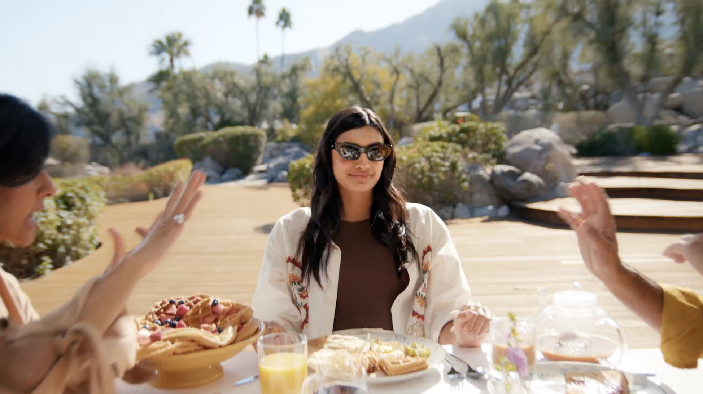

How Your Creative Signals Show Up in Market
Social Connection Drives Brand Resonance 117 Social Index
Sunglass Hut over-indexes at 117 on Social elements, with creative consistently portraying the product within group settings, beach gatherings, and shared moments. This positions the brand as the lifestyle enabler — not just an eyewear retailer. PurePlay amplifies this signal by prioritizing Premium and Ultra-Premium CTV inventory where high-attention, lifestyle-oriented programming resonates.
Experience-First Messaging Captures Youth 125 Experience Index
Sunglass Hut significantly over-indexes at 125 on Experience and 129 on Adults 18–34, showcasing the product across diverse settings — beaches, music festivals, everyday outings. PurePlay reinforces this through strategic placement on streaming platforms popular with young adults — Peacock, Hulu.
Lifestyle-First — The Store Overlay Bridge 0% CTAs in Creative
Sunglass Hut’s creative is 100% lifestyle and emotional — zero CTAs, zero promotional messaging. The third-party store location overlay (nearest store + distance-to-store) serves as the functional CTA the creative itself doesn’t provide — turning emotional resonance into measurable store visits.

Slide 7
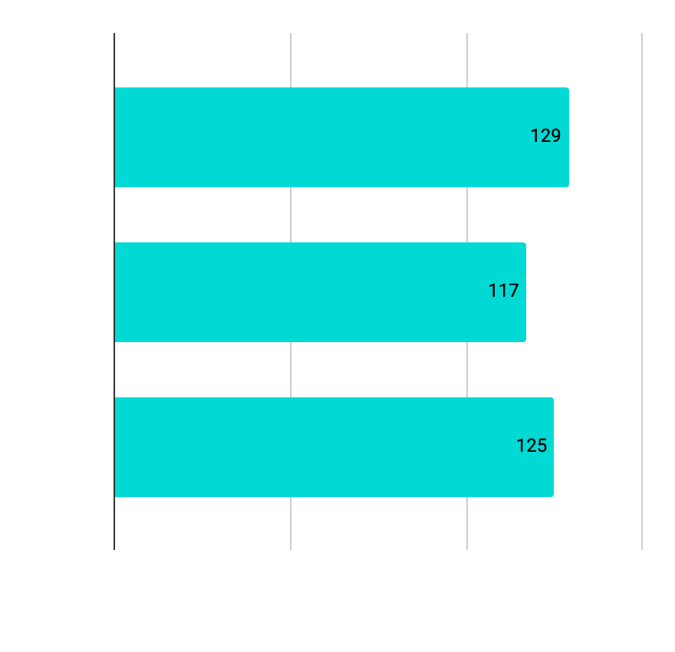
Performance Metrics & Indices
Data-driven insights powering your media strategy
Persuasion Drivers
Index vs. Benchmark
Audience Performance
Index Scores
Creative Format Mix
Distribution & Index
80%
Adults 18-34 | 129 | ↑ Over-Index
Social Trendsetters | 117 | ↑ Over-Index
Experience Seekers | 125 | ↑ Over-Index
Practical Shoppers | 68 | ↓ Under-Index
Social Lifestyle Montage
Index: 117
Lifestyle Montage: 80%
Other: 20%
100 = Benchmark
100 = Market Average
67% Lifestyle Montage, 33% Narrative | 0% CTAs, 0% Promos
KEY INSIGHT Sunglass Hut’s 100% lifestyle creative with 0% CTAs is a distinctive brand choice. The media environment and store location overlay must bridge emotional resonance to store visits.

Slide 8


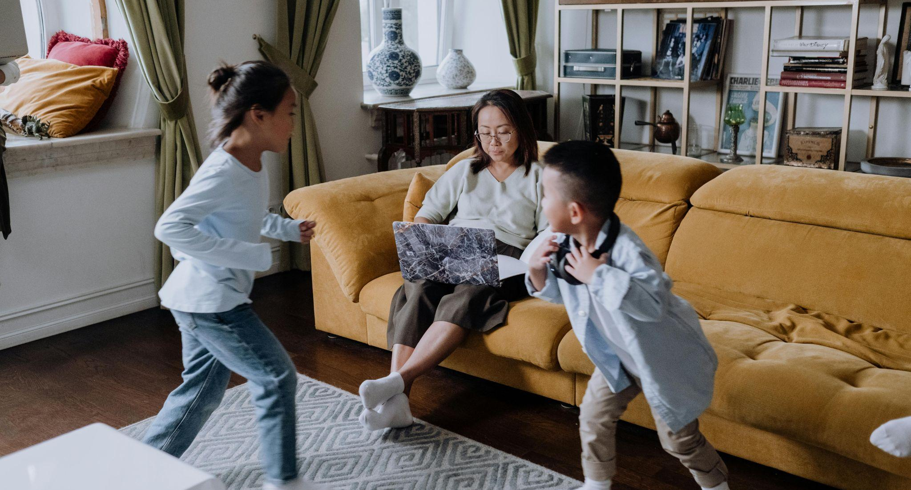
Targeting Where It Matters Most - Expansion Opportunities
Turning broad reach into measurable performance through audience precision.
Adults 18-34 | Primary
129 Index
Experience Seekers | Growth
125 Index
Style Conscious | Differentiation
88 Index
Signal
Massively over-indexes at 129, outpacing competitors. Creative emphasis on social gatherings, music festivals, and beach outings directly signals this demographic.
Strategy
Prioritize Premium CTV apps with high 18–34 penetration: Peacock, Roku. High-frequency evening/weekend dayparts. CPV-optimized DMA allocation. Expand through credit card/purchase data targeting. Tighten HHI floor based on historical performance.
Signal
125 index on Experience reveals whitespace. Creative showcases travel, outdoor activities, social events — signaling versatility. Summer transforms this into travel planning, festival culture, and wellness.
Strategy
Contextual CTV targeting on travel, lifestyle, wellness programming. Front-load around Memorial Day, July 4th, back-to-school to capitalize on proven short visit latency windows.
Signal
Under-indexes at 88 on Identity but creative features stylish individuals in fashionable settings. QUAY dominates (135) but SGH can differentiate through accessible, versatile style.
Strategy
Test Premium Niche fashion/lifestyle CTV apps (Bravo on Peacock, Hulu). Fashion & Beauty targeting. Dynamic high-impact overlays with designer eyewear lines for this audience.

Slide 9









PurePlay Activation Solution
Sunglass Hut Inventory Mix
Informed by Pulse Platform Intelligence
Performance-Optimized Publisher Mix
Historical data establishes a clear tiering framework. PurePlay maintains proven scale publishers while increasing allocation to emerging high-efficiency apps. Publishers showing declining efficiency are reduced and reallocated toward winners.
Netflix
Holiday data validated performance. Pending Netflix confirmation that we can continue established measurement workflow.
Content Alignment < 35% Sports
Fashion, Summer, Travel, Music, and Wellness programming receive focused spend. Sports-related inventory capped given existing linear coverage across NBA Finals, WNBA, and SNL – as well as World Cup related content across news, highlights, and more!
Whitespace Expansion
PurePlay identifies low-competition streaming environments where Sunglass Hut can replicate the proven niche dominance playbook — achieving near-total SOV in apps competitors aren’t touching.
Inclusion/Exclusion Lists Supported!
100% Transparency
Guaranteed Delivery Toward Ultra-Premium Publishers

Slide 10
Dynamic Moment Creative (Tiers 1 & 2)
Audience-matched creative designed for real-world impact.
Every impression tied back to foot traffic with store locator overlays bridging the ad to the door.
SPORTS & TECH AUDIENCES
Oakley/Ray-Ban Meta Dynamic Product Overlays
Precision-crafted for sports-minded and tech-forward viewers.
Dynamic Oakley Meta formats serve high-performance visuals that match the intensity of the moment — from game-day surges to product drop cycles. Creative adapts in real time to context, content, and viewer behavior, keeping your brand in frame when intent is at its peak.
TIER 1
$750K
UNLOCKS
Oakley/Ray-Ban Meta Creative + Summer Lifestyle Overlays
Store Locator Overlays
CULTURAL AUDIENCES
Summer Lifestyle Overlays
Built for cultural resonance, not just reach.
Summer lifestyle overlays layer season-specific visuals and messaging over content — connecting with diverse audiences through aesthetics that feel native to their world. Style, sound, and culture drive the creative so every impression lands with relevance and warmth.
TIER 2
$600K
UNLOCKS
Summer Lifestyle Overlays
Store Locator Overlays

Slide 11
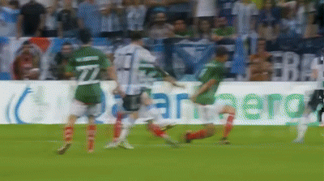
WHAT AN OAKLEY META CREATIVE OVERLAY DELIVERS
Real-Time Agentic Overlay
Dynamic creatives synced to live match moments.
Multimodal Audience Signals
Audio, visual, and behavior intelligence at scale.
Cultural Moment Targeting
Goals, replays, half-time – reach the peak.
Brand-Safe High Impact
Premium placements across 200+ markets.
Join The World’s
Biggest Stage
FIFA World Cup 2026 – North America
5B+ Global Viewers | 104 Matches | #1 Most Watched Event on Earth
ACTIVATE WITH PUREPLAY CULTURAL MOMENT
EVERY FAN. EVERY MOMENT. EVERY MARKET.

Slide 12
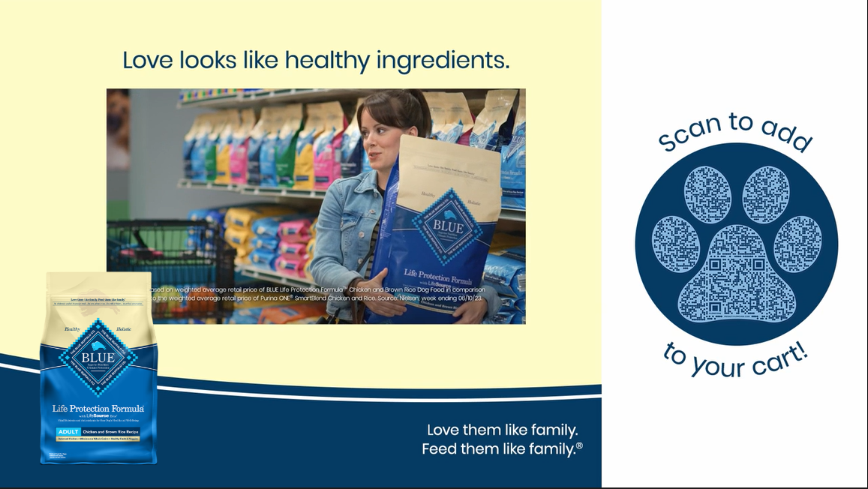
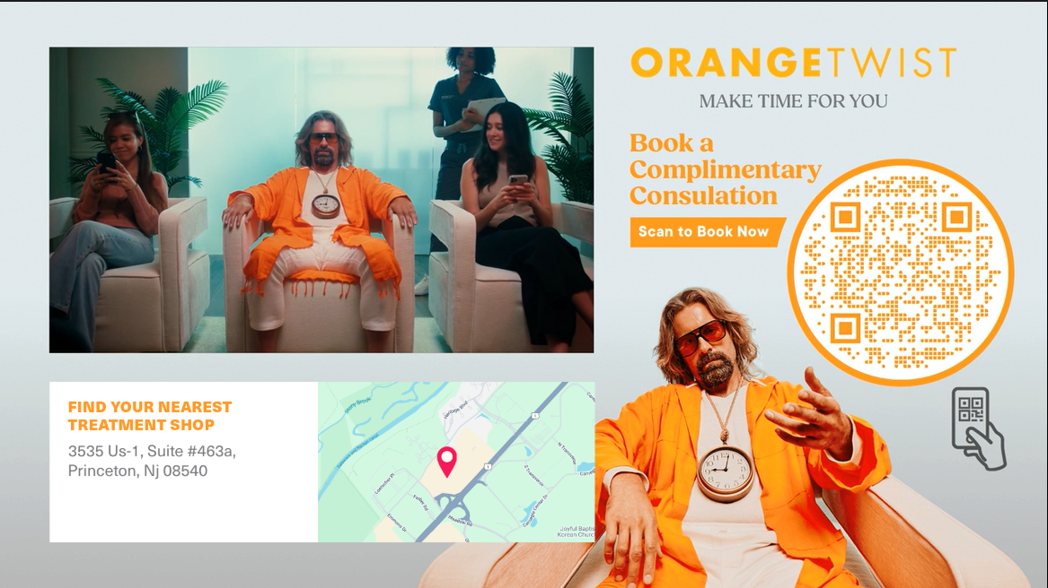
Dynamic Moment Creatives
Ultra, Core, and Niche create a complete premium strategy: built for style seekers, optimized for summer, and engineered to maximize in-store visits & sales momentum.
Shoppable Branded Canvas
: Pre-roll video is scaled down to accommodate a branded skin featuring additional branding and/or:
Dynamic elements can further personalize the content
Dynamic Store Locator
A Canvas layout that presents the viewer with the nearest brick & mortar location based on the viewer’s IP address. This can include an optional map of the area. Add product customization and/or a QR Code to make it a shoppable experience.

Slide 13
Premium At Every Level
Ultra, Core, and Niche create a complete premium strategy: built for style seekers, optimized for summer, and engineered to maximize in-store visits & sales momentum.
Ultra-Premium
Premium Niche
Premium Core
Netflix · Hulu · Peacock
FuboTV · AMC+ · HGTV GO · BET+ · Tennis Channel
Sling · Roku · Whitespace Apps
Flagship streaming environments with the highest completion rates and brand-safe, premium content.
Aligns Sunglass Hut with culturally relevant programming across fashion, travel, music, and wellness — driving upper-funnel awareness in high-attention environments.
Targeted, contextually rich apps where Sunglass Hut achieves near-total SOV dominance — the proven competitive moat. FuboTV emerging top performer + World Cup alignment.
Dynamic overlays: designer eyewear for fashion, Ray-Ban Meta for tech/fashion, Oakley Meta for tech/sports.
Scale-efficient CTV and OLV that extends reach while maintaining brand quality. All validated by historical visit rate performance. Strategic whitespace apps provide cost-efficient reach among younger cord-cutters.
All allocations optimized toward lowest CPV.
Fubo
Disney+
Fox One

Slide 14
Competitive Landscape Analysis
Sunglass Hut vs Warby Parker, Quay, Goodr, Krewe, DIFF, Walmart, and Amazon — Share of Voice & Strategic Positioning
Sunglass Hut Market Position
Distribution & Index
Niche App Dominance — Our Competitive Moat
PurePlay delivers near-total SOV ownership on premium niche apps where competitors have minimal presence. This proven niche dominance playbook expands into travel, wellness, lifestyle, and music environments for summer.
14%
Average SOV across DMAs
Competitive separation guaranteed from Warby Parker, Quay, Goodr, Krewe, DIFF, Walmart, and Amazon across all PurePlay inventory.
Ray-Ban Meta & Oakley Meta - Overlap Opportunity
As the #1 retailer of Ray-Ban Meta and Oakley Meta, Sunglass Hut has a unique strategic advantage. PurePlay identifies overlap audiences — consumers actively interested in smart eyewear — and serves dynamic creative that positions Sunglass Hut as the destination retailer. Competitor interest becomes store traffic.

Slide 15
Local Market Analysis — CPV-Optimized Strategy
Proven Market Winners
Underperforming – Reduce / Reallocate
Market | Efficiency Gain | Action
Dallas | +13% | Increase
Tampa | +85% | Increase
Miami | +32% | 20-22% SOV
Market | Efficiency Gain | Action
Philadelphia | -15% | Reduce
Raleigh | -44% | Reduce
Las Vegas | -47% | Reallocate
Publisher-Level Geo Optimization
Within each DMA, inventory allocation shifts dynamically toward the publishers and apps delivering the strongest CPV.
DMA-level reallocation proved highly effective in prior campaigns — PurePlay’s Pulse Platform enables this optimization in real time across the 14-week summer flight. Cross-referenced against SGH’s 903-store footprint to ensure impression delivery maps to store proximity.

Slide 16
PurePlay x Cuebiq Partnership
PurePlay uses Cuebiq’s verified foot traffic data as a live feedback signal — not just a measurement tool.
By layering store visitation data with multimodal creative intelligence and competitive share-of-voice, PurePlay dynamically influences bid logic and creative weighting in real time. The result is incremental CPV efficiency that standard measurement integrations alone cannot deliver.
How PurePlay Uses It
Signal → Action Verified foot traffic data enters PurePlay’s system as a live optimization input — not a post-campaign report. Every bid and creative decision is anchored to real in-store behavior.
17% | above foot traffic benchmarks
Sunglass Hut Proof Point Achieved by applying Cuebiq visitation feedback to dynamically adjust creative weighting and bid logic — not from Cuebiq measurement alone. The signal told us what worked. PurePlay acted on it in real time.
903 | US Store Locations
Geo-Intelligent Spend PurePlay’s Pulse AI layers store proximity into both creative and bid strategy — concentrating spend where Sunglass Hut can convert intent into a real in-store visit.
The Layering Advantage
Creative Intelligence Loop As visitation patterns shift, PurePlay recalibrates creative weighting in real time — surfacing the formats and messages driving the highest-quality store visits at the lowest CPV.

Slide 17

Pureplay x Cuebiq
Partnership
Cuebiq
Device-level foot traffic attribution that goes beyond measurement. PurePlay feeds Cuebiq visitation signals back into the optimization engine – dynamically adjusting bids and creative weighting to drive incremental CPV efficiency.
Cuebiq's foot traffic and purchase intelligence becomes a live optimization signal — dynamically adjusting bids and creative weighting to drive incremental CPV efficiency.
Affinity via Cuebiq
Purchase-based intelligence. Transaction data enriches audience construction and validates sales lift—connecting media exposure to what actually happens at the register.

